Slide 1









Operational Threat & Risk Information Sharing and Analytics
Submission Team Engagement

Slide 2
Intent
This intent of this presentation is to establish the process by which operational threat and risk contributors will collaborate to produce the standards and capabilities that meet our shared objectives

Slide 3
Who you are
This presentation is intended for parties that have agreed to engage in the community developing standards and capabilities for operational threat and risk information sharing and analytics.
It is assumed you already understand the value proposition and approach we are using, however you are not expected to be experts in data federation, standards or modeling.
Our initial work product is a response to the OMG Operational Threat & Risk RFP. You are part of the submission team and this is our current focus.
You may be a formal submitter (OMG Platform Membership required) or a contributor (Release of I.P. Required)
There may be other associated efforts such as pilot projects or mappings to data formats important in your domain, these associated efforts will benefit from and inform the standards effort but are independent efforts.

Slide 4
Who we are
We are the core team integrating requirements and specific data structures into the cross-domain conceptual model and related mappings.
We will help to facilitate structuring your information such that it can be verifiably integrated with other data formats and vocabularies in other domains.
This cross domain conceptual model will then be mapped to domain specific data structures such as XML or SQL schema as well as domain vocabularies and models.
It is assumed we already understand your domain use cases at a high level, but we are not experts in your domain and will require guidance and domain expertise to be actively engaged.

Slide 5
Understanding the standards process

Slide 6
Some thoughts about creating a standard
A warm and fuzzy feeling does not a specification make
Information architecture and data federation is a team sport
We want to focus on concepts, not get hung up on specific terms
We are not standardizing processes, we are standardizing the information that supports multiple processes. Processes can be informative but are not our focus.
It will take time for us to understand each other, we will need to talk things through in a productive manor. Resolving disagreements and different points of view is normal and constructive. The process will be iterative.
There are several ways we can present information, but in the end you will need to expend effort to understand and validate it as we will need to expend effort to understand your perspectives
The final specification must:
Be formal, precise and conform to OMG requirements and expectations
Have the commitment for implementations (open source and/or commercial)
The standards process does not end on initial submission– the finalization process takes about an additional year. The community supporting a standard must be sustained for as long as the specification is relevant or it will die.

Slide 7
What we need for the specification
Our current focus is a response to the OMG Operational threat/risk RFP. The Initial submission is due Fed 23rd, 2015. The current date for the revised submission is Aug. 24th . The initial submission is not required to be complete, think of it as a “interim deliverable” to the OMG.
Specific requirements are located in the appendix, key components are:
Use cases for cross domain information sharing and analytics – this includes data sources, data destinations and requirements for analytics.
A broad-based and detailed conceptual model of the terms and concepts relevant to sharing and analyzing cross-domain operational threat and risk information.
Computational mappings of this conceptual model to multiple existing information sharing data structures, including but not limited to NIEM, STIX & EDXL.
A “Computational mapping” means that software implementing the standard will be able to ingest, correlate and export data in any of the mapped formats for the subset of information described in the conceptual model.
Test cases – to validate conformance (Not strictly required, but highly recommended)
The specification includes the formal document as well as the “machine consumable files” for the models, mappings and any examples.
We also need to validate and prove that the mappings work, both computationally and for the intended domain use cases

Slide 8
Validation
Validation in this context means:
At the schema and conceptual level
You have provided the relevant normative data and vocabulary specifications. [You do this]
That we have described precisely how data in the various formats and vocabularies relates to conceptual model elements, expanding or refactoring the conceptual model as required. [We do this together]
That we have computationally validated that the models and mappings are consistent and well formed [We do this].
That stakeholders have validated that the mappings are valid and cover the subset of information required for cross domain information sharing and analytics. [You do this with our help]
At the “real data” level
You have provided sufficient real or sample data to validate all of the use cases. [You do this]
That we have specific data instances that computationally demonstrate the mapping in both directions. [We do this]
That stakeholders have validated that the interpretation of the data is correct in these instances and that the resulting data meets the needs described by the domain use cases. [You do this with our help]

Slide 9
Implementations
There are multiple implementation activities that may take place concurrently with or after the standards effort
No implementation effort is required (by OMG) to submit an OMG specification, however in this case it would be difficult to produce a realistic specification without some implementation experience and validation. Implementation commitment is required for an OMG standard to be adopted by the OMG Board.
Prototypes: Prototypes help prove and validate the specification. In this context prototyping is needed to validate that our models are consistent and to computationally demonstrate and validate data mappings. Prototypes are not intended to be part of operational systems.
Pilots: Pilots utilize some aspect of the specification to solve a real-world problem - this demonstrates usefulness and practicality. Pilots may or may not be deployable as operational systems.
Reference implementations: Reference implementations, typically open source, provide a complete “sample” implementation of the specification. This can help those implementing solutions or commercial products and serves to support testing. While the community may recognize a reference implementation, OMG can not.
Products (open source or commercial): Products are software products that conform to the specification and can be deployed to solve real-world problems (applications or systems) or enable the solution of real-world problems (tools and infrastructure). Of course products have to be sustained, supported and evolved.
Implementation plans are, at this time TBD.

Slide 10
Potential Roadmap
Evolving use cases
Multiple collaboration sessions to focus scope, understanding and intent
Source data and schema
Validation sessions
Initial specification and prototype incorporating 2 domain mappings
One or two pilot projects concurrent with the specification process
Final revised specification is delivered with a “beta” unofficial open source reference implementation and 4 domain mappings
Open source reference implementation and at least one commercial product is released within one year of adoption

Slide 11
Time Investment Required
What we* need to develop the specification
* “We” is the entire team, you included

Slide 12
Kinds of collaboration
Information “data calls”
Authoring/sharing content
Weekly team meetings
Exchange on GITHUB and portal[TBD]
Domain centric collaboration & validation sessions (face-face preferred)
Cross domain collaboration & validation sessions (face-face preferred)
Review of draft models and specifications
Prototypes and pilots
Presentations and expanding the community
It is up to the community to decide how we will collaborate to produce standards and capabilities. Ultimately all of the above will be required.

Slide 13
Collecting information
Note that we need to develop the following information, but it is not required to formalize everything.
Restructuring existing information is not required, existing documents and systems artifacts may be used to feed the beast
This is intended to lead to the resulting specification, it need not be shared.

Slide 14
Specific use cases
What are the use cases relevant to you?
For each, what are the specific outcomes?
What specific data is required for each outcome?

Slide 15
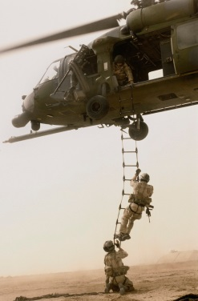
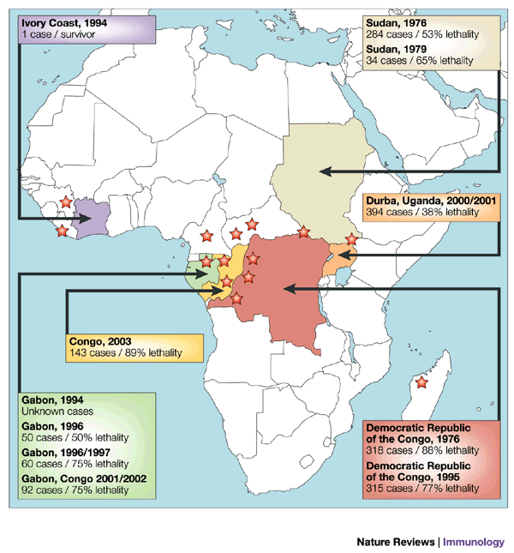

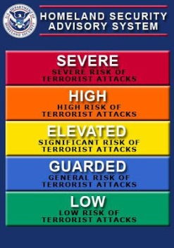



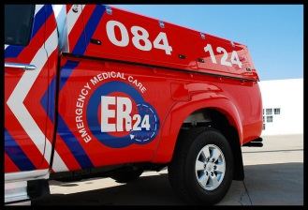


Roles in our community
Data
Sources
Data Fusion
& Brokering
Analysts
Responders
One organization may play multiple roles

Slide 16
Specific artifacts
For each of these roles we will need to understand what they do and should do to operate in the community
We will also need any specific artifacts:
Data schema
Real or sample data (Very important)
Models & architectures
Vocabularies, ontologies or data dictionaries
Processes
Forms or reports
Existing systems

Slide 17
Data Sources
Who are the data sources in your community? Are you a source?
What data to they provide now? What data should they provide?
Who do they provide it to? Who should they provide it to?
How is it provided now? How should it be provided in the future (Assume that policy issues are resolved – we are not concerned with policy at this time)
What are the data formats, entities, elements, associations and vocabularies?
What existing artifacts are there? (See above)

Slide 18
Data fusion and brokering
Who are the data brokers in your community? Are you a broker?
Who do they consume data from? Who should they consume data from?
What data to they consume & provide now? What data should they consume & provide?
Who do they provide the data to? Who should they provide it to?
How is it consumed/provided now? How should it be consumed/provided in the future (Assume that policy issues are resolved – we are not concerned with policy at this time)
What are the data formats, entities, elements, associations and vocabularies?
What existing artifacts are there?

Slide 19
Analysts
Who are the analysts in your community? Are you an analyst?
Who do they consume data from? Who should they consume data from?
What analytics do the do? What should the do?
What data to they consume & provide now? What data should they consume & provide?
Who do they provide the data to? Who should they provide it to?
How is it consumed/provided now? How should it be consumed/provided in the future
What are the data formats, entities, elements, associations and vocabularies?
What existing artifacts are there?

Slide 20
Responders
Who are the responders in your community? Are you a responder?
Who do they consume data from? Who should they consume data from?
What data to they consume now? What data should they consume?
How are they equipped to make decisions and respond? How should they be equipped?
How is data consumed now? How should it be consumed in the future What are the data formats, entities, elements, associations and vocabularies?
What existing artifacts are there?

Slide 21
Use case resolution
How do the data and interactions above fulfill each of the use-case outcomes?

Slide 22
Understanding the conceptual models

Slide 23
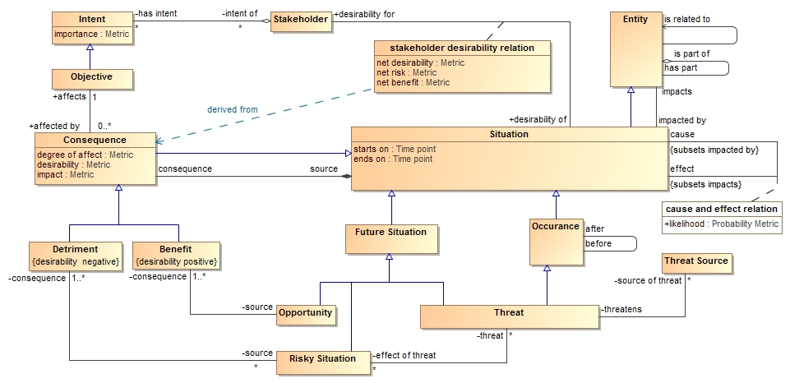
Understanding the UML diagrams & Tables
--todo--

Slide 24
Representing your data and schema
Options
UML Model
Tables
Schema
Examples

Slide 25
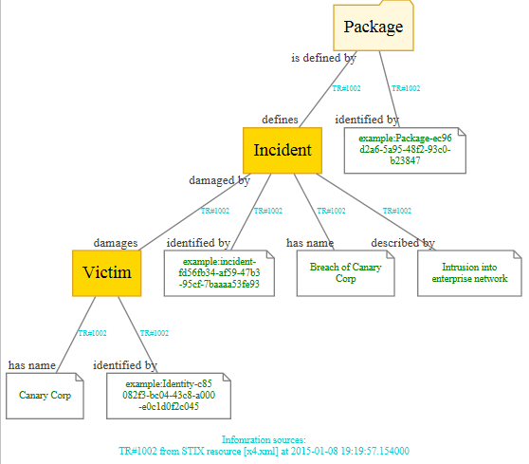
Example of mapped data

Slide 26
Process checklist
Step | Status
Use cases identified
Collaboration sessions defined need and way forward
Existing schema/ontologies/models provided
Real or example data provided
High level: Data sources, brokers, analysts & responders identified
Detailed artifacts for the above specified (as is and to be)
Existing conceptual model understood
Mapping validation session(s)
2-way mapping between schema and conceptual model defined, any required changes made to conceptual model
Concept definitions validated
Use case outcomes validated
Schema and real/example data transformations validated with prototype
Concepts and mappings documented for submission
Final validation collaboration session

Slide 27
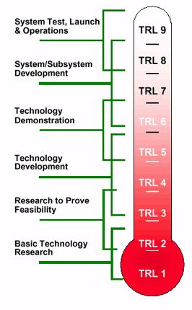
Consider the technology readiness level required for any pilots/prototypes

